Slide 1
Organizational Structure

Slide 2
Learning Goals
Use a simple organisation chart to explain characteristics of organisational structure: hierarchy, chain of command, wide / narrow span of control, and delayering.
Distinguish between 'Authority' and 'Responsibility'.
Explain the features of 'centralised' and 'decentralised' organisation structures.
Discuss the advantages and disadvantages of delegation, for both managers and subordinates.

Slide 3

Formal Organization
The Internal Structure of a business is determined by:
Interrelationships between individuals.
Who is the boss.
Who has the authority to make decisions.
Who carries out those decisions.
How is information communicated.

Slide 4

Organization in Business
The Business Structure may be:
Developed as a result of the employees.
Created first, with all positions outlined, then people are hired to fill them.
A mix of both.

Slide 5
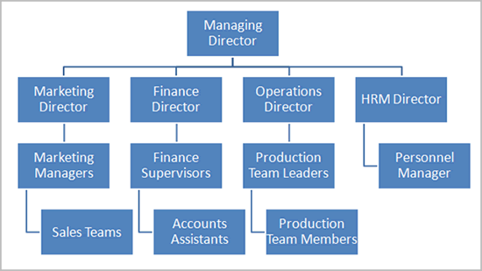
Organizational Charts
Why create a chart?
Spot communication problems.
Make the structure easy to see, understand, and communicate.
Recognize organizational needs;
Specialists
Restructuring
Stream-lining

Slide 6
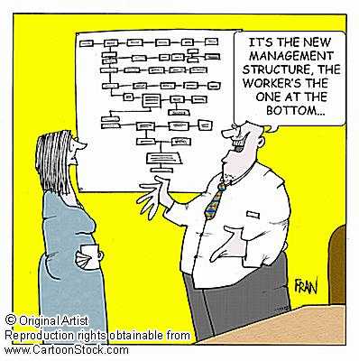
Hierarchy
Chain of Command – Shows who has authority for which areas of the business and who is responsible to whom.
Longer = less effective communication
Shorter = more individual responsibility

Slide 7
Span of Control
Number functions / areas of business, people, or things, for which a manager is responsible.
3-6 is preferred… Why?
Tight managerial control from the top.
Limitations to any single managers ability to control people and activities.
Subordinates (Definition) – People under the authority or control of a manager, within an organization.

Slide 8
Tall Structure
Long Chain of Command
Narrow Span of Control

Slide 9
Flat Structure
Short Chain of Command
Wide Span of Control

Slide 10
Responsibility vs. Authority
Responsibility
Being accountable to someone else for both your own actions as well as the actions of your subordinates.
Authority
The ability to make the decisions needed to complete a task.
Power which comes from the job.

Slide 11
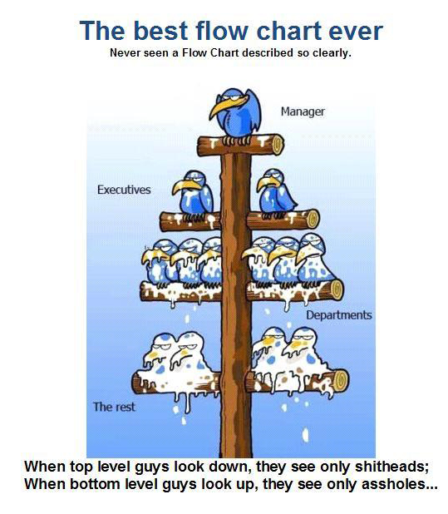
Types of Authority
Line Authority
Typical of hierarchy.
The power that a manager has over a subordinate.
The authority flows down the ‘corporate ladder’ from the top.

Slide 12
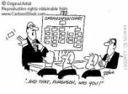
Types of Authority
Staff Authority
A manager or department has an advisory function within another.
E.g. A marketing manager provides specialist advice to the production department.
Specialists are only advisors and have no authority to make decisions in the other department.

Slide 13
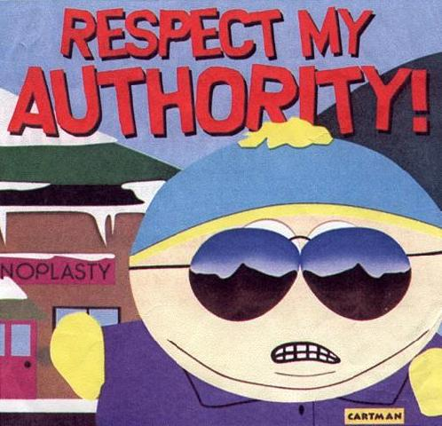
Types of Authority
Functional Authority
The authority comes from the business function. So, the specialist has the authority to make a line manager accept his/her advice
E.g. A Finance specialist may have functional authority over a marketing manager in terms of their budget.

Slide 14
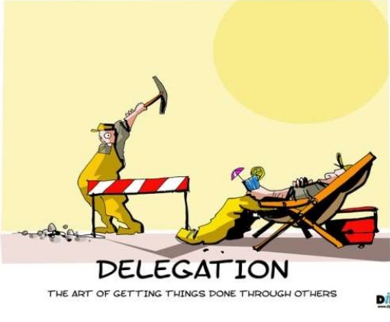
Delegation
Definition:
To give the authority and responsibility for a task / area of responsibility to a subordinate.
With your partner discuss;
Benefits and problems of delegation

Slide 15
Delegation
Empowering others to make decisions and carry more responsibility.
When is it effective?
When managers have confidence in their subordinates
If managers set clear goals and expectations
When managers avoid “passing the buck”
Employees are given responsibility AND authority
(Linked to Motivation)

Slide 16
Centralisation vs. Decentralisation
Subordinate Authority
Complete Centralization
Complete Decentralization
Subordinates have no authority and all decisions are made by senior leaders.
Very rare in business (Military).
Subordinates have the authority to take all decisions.
Very rare in business (Doctors in a hospital).

Slide 17
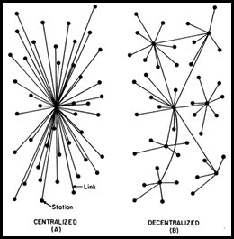
Advantages of Decentralisation
Improves motivation
Reduces burden on senior management
Increases job satisfaction of employees
More flexibility and quicker response times

Slide 18
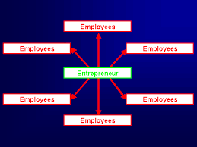
Types of Business Structures
Entrepreneurial
Ideal for small business
Decisions can be made quickly
Clear chain of command
Not suitable for larger organizations
Finance
Information Tech.
Human Resources
Entrepreneur
Sales & Marketing
Production
Research & Development

Slide 19
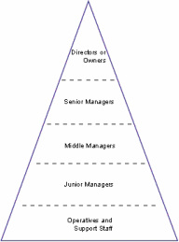
Types of Business Structures
Hierarchal/Pyramid
Traditional business structure
Decision making is shared throughout the business
Specialisation of tasks
Directors /Owners
Senior Managers
Middle Managers
Junior Managers
Staff

Slide 20
Types of Business Structures
Marketing
Finance
Operations
Project X Manager
Project Y Manager
Matrix Structure
Project teams made up of specialists
Improves flexibility and motivation of employees
Preferred by managers
Can be expensive and difficult to coordinate

Slide 21
Types of Business Structures
Independence Structure
Emphasis on the individual
Requires highly skilled and independent workers;
Doctors
Lawyers

Slide 22
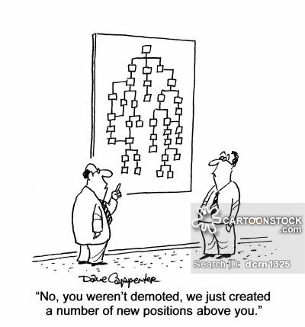
Factors Influencing Structure
Size
Leadership style and goals of owners/senior managers
Business objectives
External Factors
Competition
Industry
Economic climate

Slide 23
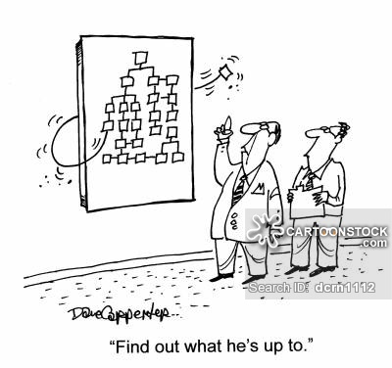
Factors Influencing Structure
Changes in Technology
Informal structures within the organisation
Corporate Culture
Power Culture - entrepreneurial structure
Role Culture - pyramid Structure
Task Culture - matrix structure
Person Culture - independence structure

Slide 24
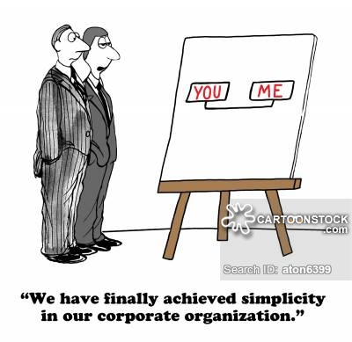
Recent Trends
“Delayering”(Next slide)
Profit centres
Multi-skilled teams
Flatter, more team based

Slide 25
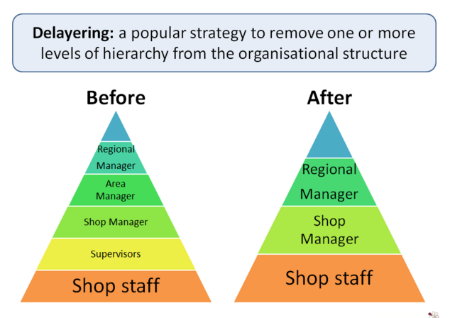

Slide 26
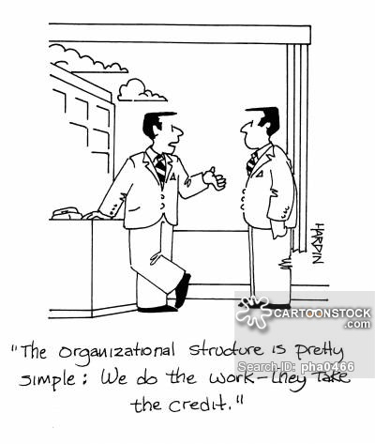
“Delayering”
Reducing the size of a hierarchy, by taking out layers of management.
The layers removed are usually ‘Middle’ managers.
E.g. - Bank managers responsible for several branches.
A Director of Studies managing several schools.

Slide 27
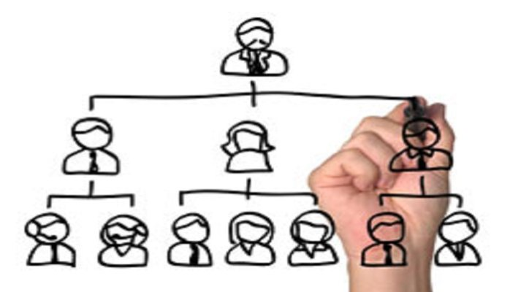
“Delayering”
May not involve cutting jobs and overheads.
Does involve increasing the span of control for managers.
Layers can be removed without removing a single person, just be moving them around.

Slide 28
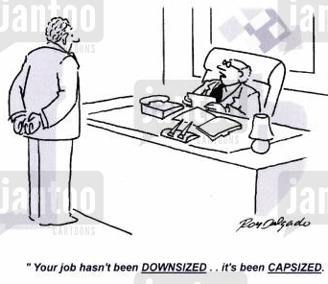
Advantages
Opportunities for better delegation, empowerment, and motivation, as authority is passed downwards.
Improved communication.
Reduces departmental rivalries.
Cost savings
Can encourage innovation.
Senior managers are closer to the customers.

Slide 29
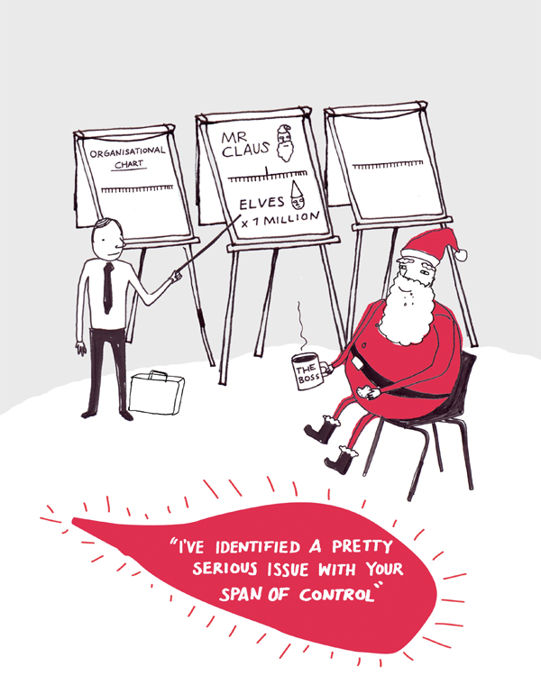
Disadvantages
Doesn’t suit some manufacturing businesses with low-skilled workers.
Can negatively affect motivation in the short-term, due to the number of job losses.
May cause confusion during the change.
May cause shortages of certain skills and experience.
The increased workload of remaining managers may be too much work.

Slide 30
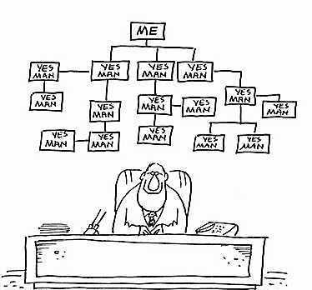
Any Questions??

Slide 31
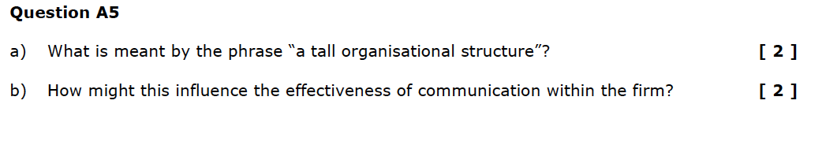

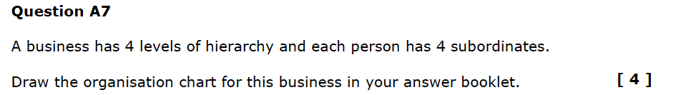
Homework Exam Practice:
Section A 2008/9
Section A 2013/14

Slide 32
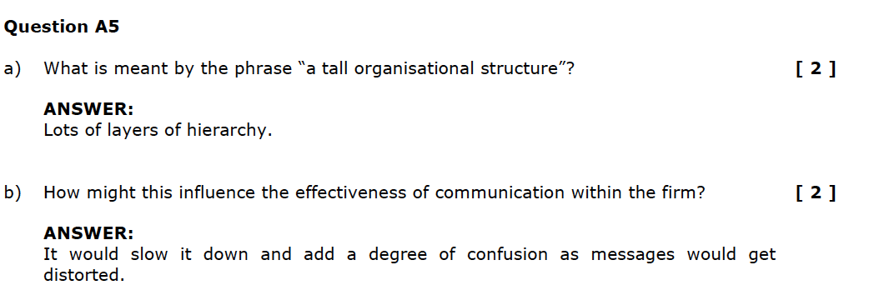
Answer Keys

Slide 33
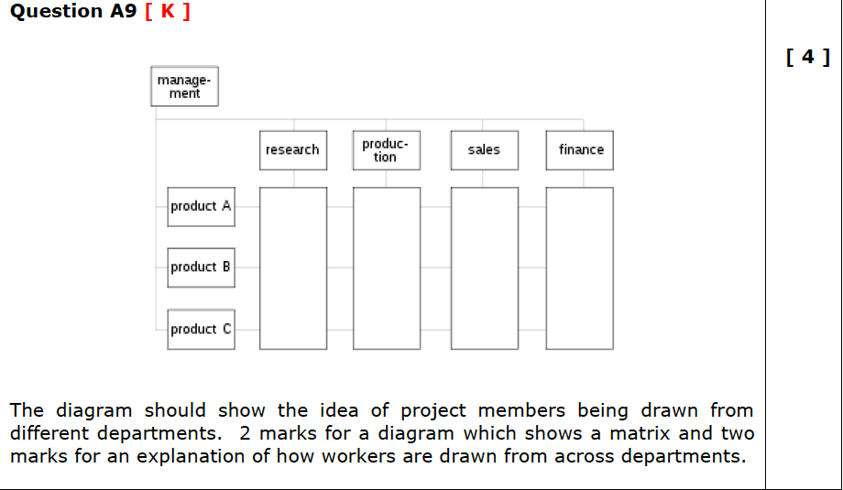

Slide 34
